Slide 1
Creating a virtual machine using Terraform

Slide 2
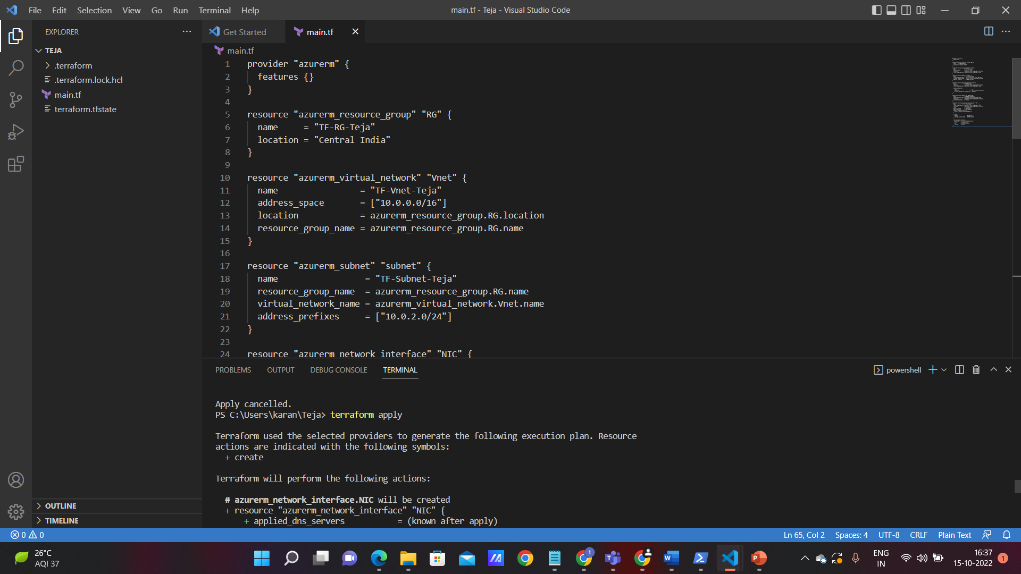
Terraform code to create a virtual machine

Slide 3
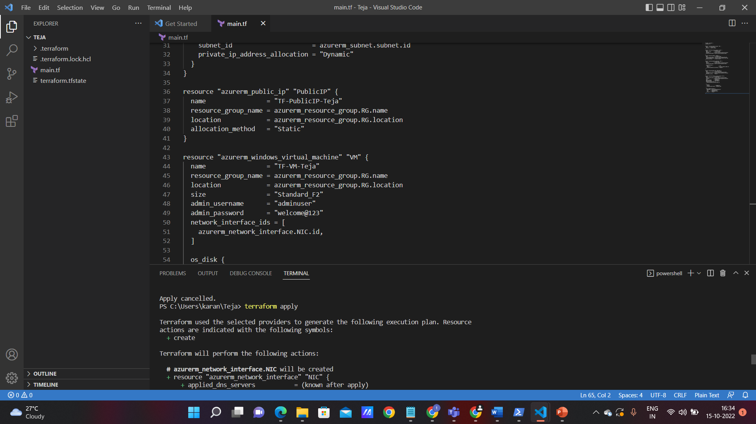
Initializing terraform using powershell

Slide 4
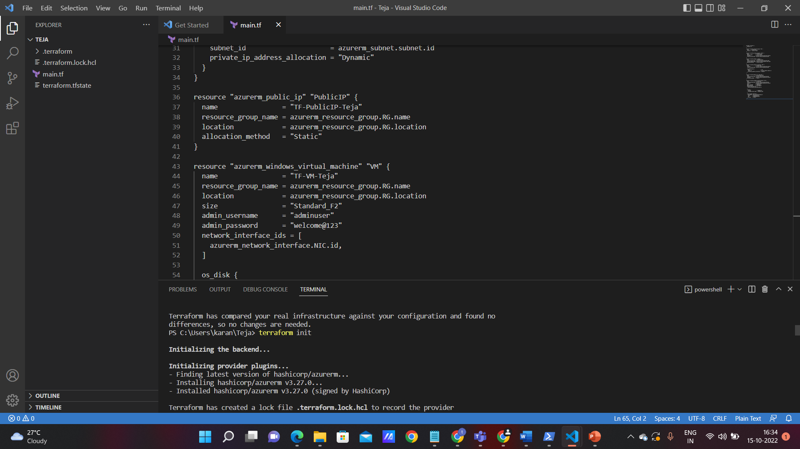
Terraform init

Slide 5
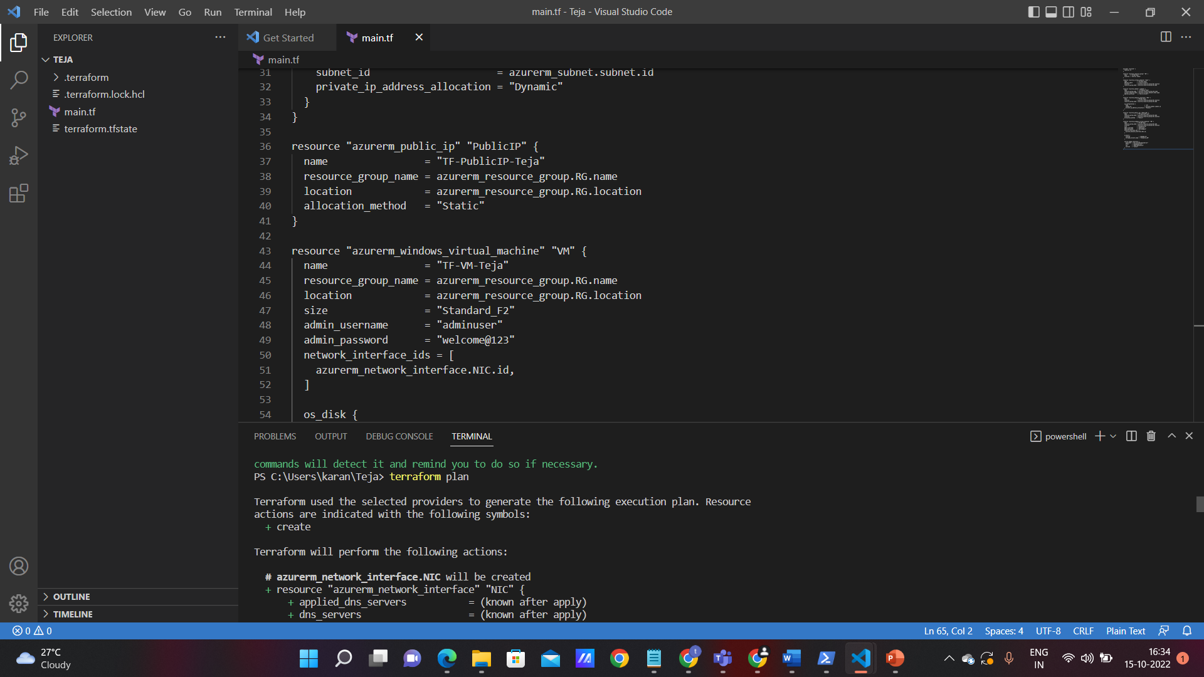
Terraform plan

Slide 6
Terraform apply

Slide 7
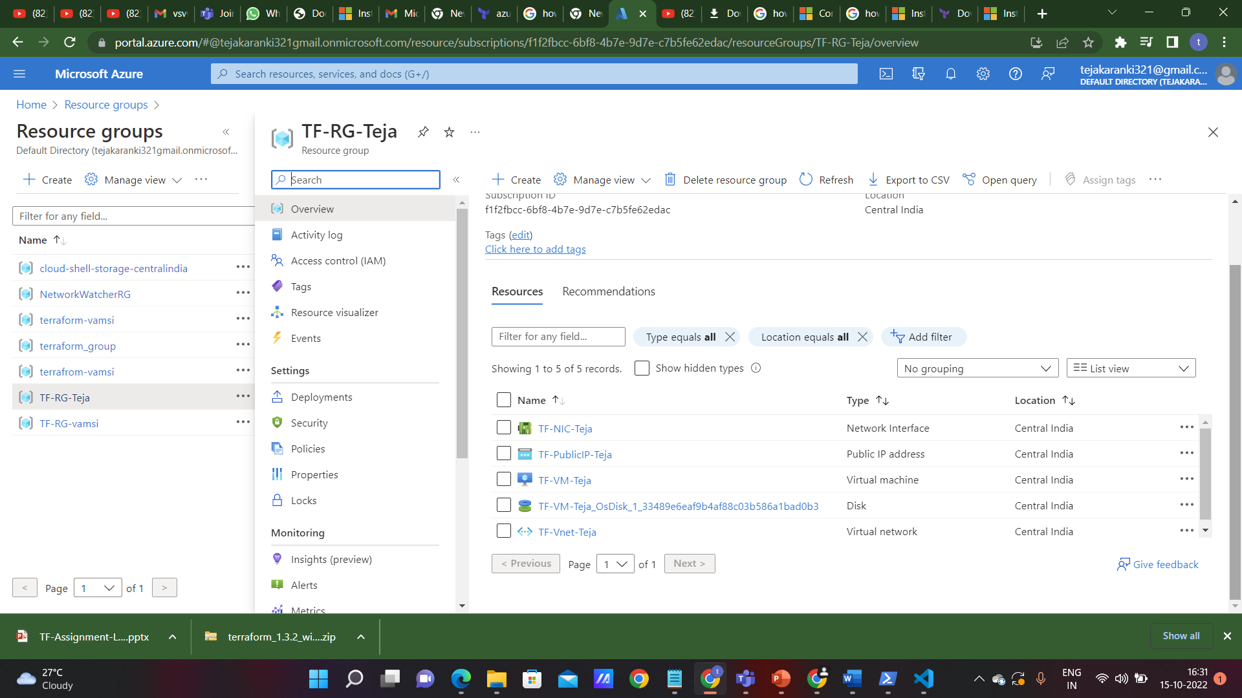
Resource group created using Terraform script

Slide 8
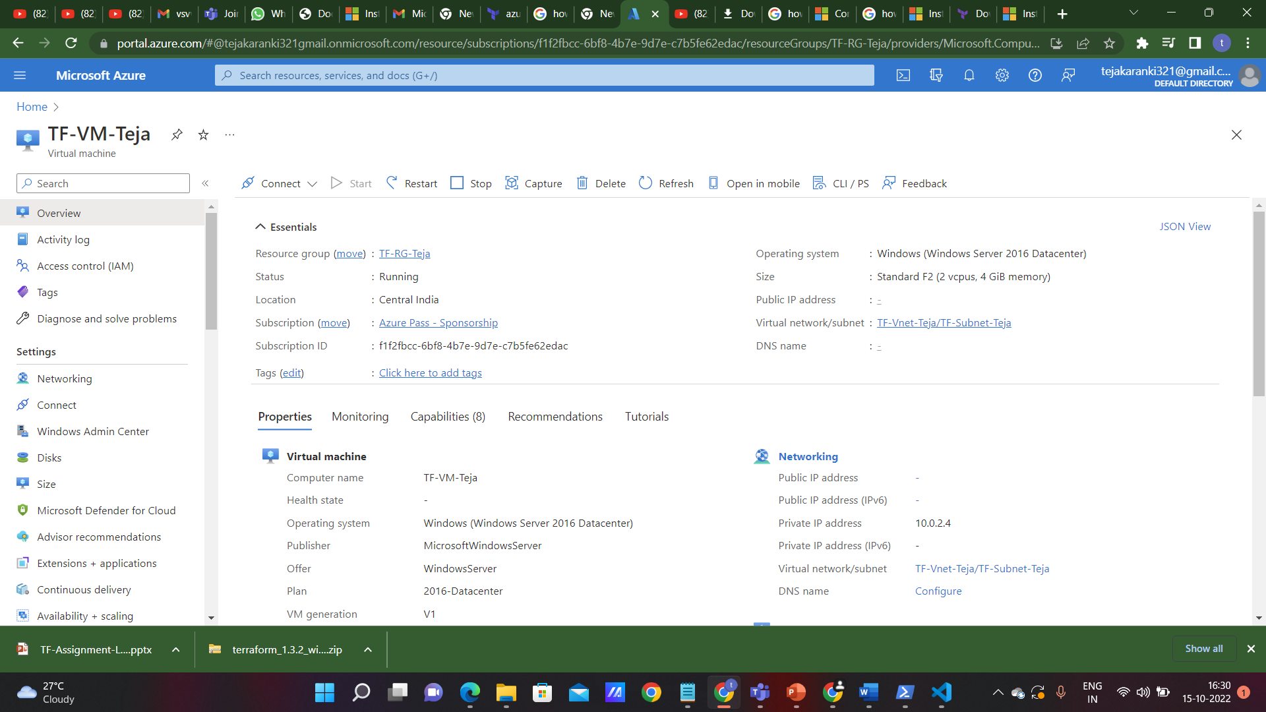
Virtual machine created by using Terraform script

Slide 9
THANK YOU

